Slide 1
The Battle of Neighbourhoods
French Restaurants in new york
By,
Piyush Sambhi

Slide 2
Introduction:
New York City's demographics show that it is a large and ethnically diverse metropolis.
It is the largest city in the United States.
New York City has also been a major point of entry for immigrants.
800 languages are spoken in New York, making it the most linguistically diverse city in the world.
French Population in New York
The French Embassy estimates that about 75,000 French citizens live in the New York metropolitan area.
60,000 French citizens and over 81,000 French speakers live in New York, but have no such hub.
French is the fourth most spoken language in New York.
New Yorkers are extreme francophiles: they love French culture, food, cinema.
The French presence is felt through the hundreds of French shops and restaurants.
Notes:
Insert a map of your country.
2

Slide 3
Problem:
The objective is to locate and recommend which neighbourhood in New York City will be best choice to start a new French restaurant.
List and visualize all major parts of New York City that has great French restaurants.
What is best location in New York City for French Cuisine?
Which areas have potential French Restaurant Market?
Which all areas lack French Restaurants?
Which is the best place to stay if you prefer French Cuisine?
Notes:
Insert a picture of one of the geographic features of your country.
3

Slide 4
Data Section:
For this project we need the following data:
1. New York City data contains list Boroughs, Neighbourhoods along with their latitudes
and longitudes.
Data source : https://cocl.us/new_york_dataset
Description: This data set contains the required information. we will use this data set to explore
various neighbourhoods of New York City.
2. French restaurants in each neighbourhood of New York City.
Data source : Foursquare API
Description: By using this API we will get all the venues in each neighbourhood, then filter these
venues to get only French restaurants.
3. GeoSpace data
Data source : https://data.cityofnewyork.us/City-Government/Borough-Boundaries/tqmj-j8zm
Description: By using this geo space data we will get the New York Borough boundaries that will help
us visualize choropleth map.
Notes:
Insert a picture illustrating a season in your country.
4

Slide 5
Methodology:
We begin by collecting the New York city data from the following link "https://cocl.us/new_york_dataset“
Find all venues for each neighbourhood using Foursquare API.
Filter out all venues with Indian restaurant for further analysis.
Next using Foursquare API, we will find the Ratings, Tips, and Number of Likes for all the French Restaurants.
Sort Neighbourhoods and Borough data keeping Ratings as the constraint.
Next we will consider all the neighbourhoods with average rating greater or equal 8.0 to visualize on map.
We will join this dataset to original New York data to get longitude and latitude.
Finally, we will visualize the Neighbourhoods and Borough based on average Rating using python’s Folium library.
Notes:
Insert a picture of an animal and or plant found in your country.
5

Slide 6
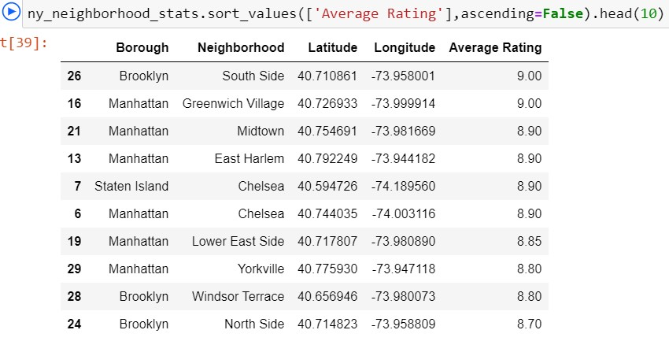
Conclusion:
The following location in New York City has great French restaurants.
Manhattan, Brooklyn and Bronx are the best Borough for French cuisine.
2. Manhattan have the best potential for French Restaurant Market.
3. Brooklyn has the best likes and ratings for French Restaurants.
4. Both Manhattan and Brooklyn are the best place to stay if you prefer French Cuisine.
Notes:
6
Add key points in the history of your country to the timeline.

